Slide 1
2024.07.30
한성재

Slide 2
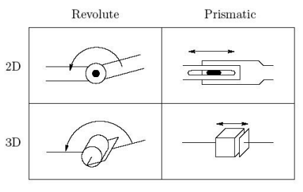
1강 로봇공학 개요
Revolute joint allows relative rotation between two links
Prismatic joint allows linear relative motion between two links
Degrees of Freedom: The number of joints determines the DOF of the manipulator
Reachable workspace: entire set of points reachable by the manipulator(어떻게든 닿을 수 있는 위치)
Dexterous workspace: subset of the reachable workspace that the manipulator can reach with an arbitrary orientation of the end-effector(특정 위치에 임의의 방향으로 접근 가능한 위치)

Slide 3
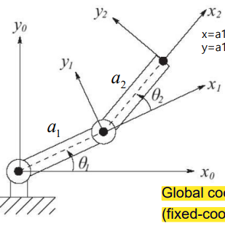




1강 로봇공학 개요
Forward Kinematics :
Determination of the position and orientation of the end-effector or tool in terms of joint variables(angle or displacement)
Tool Position
Tool Orientation

Slide 4
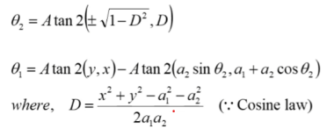
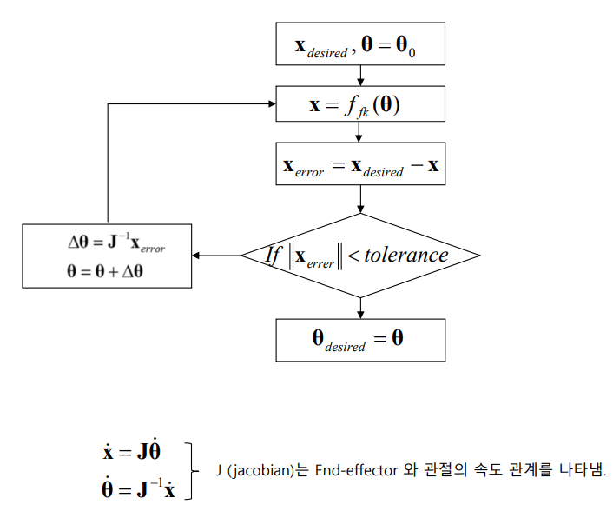
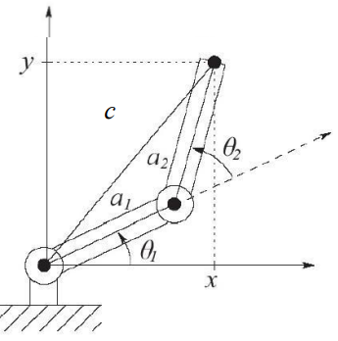
1강 로봇공학 개요
Inverse Kinematics :
Determination of the angle or displacement of the end-effector or tool in terms of joint
variables(position and orientation)
Equation
Numerical Solution
초기 각도 설정값
허용 오차 ex) 0.001

Slide 5
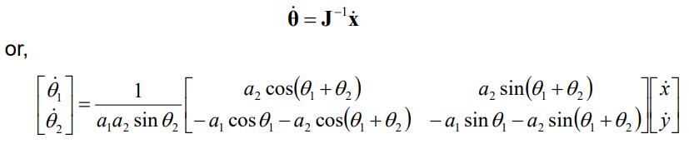

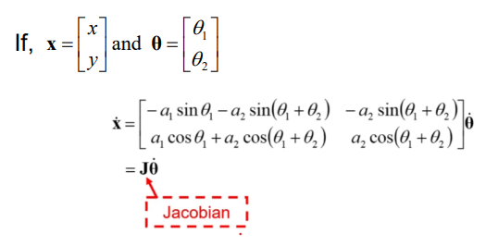
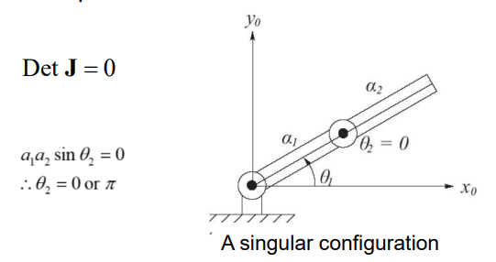
1강 로봇공학 개요
Velocity kinematics :
In other to control velocity, calculation the relationship between the velocity of the tool and the joint velocities.
Differentiation of tool position at Forward kinematics
Singular Configuration:
where there is no inverse Jacobian

Slide 6
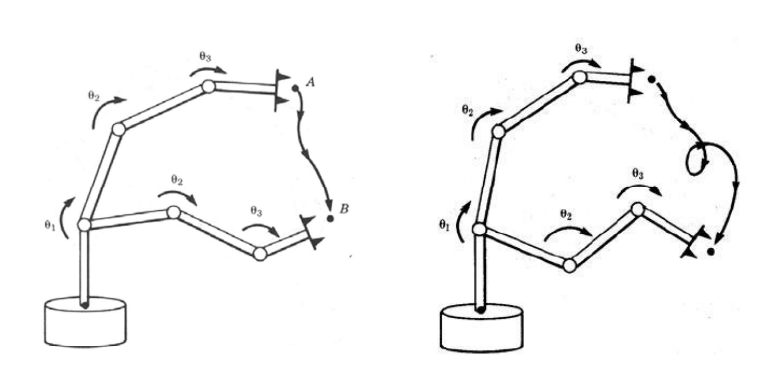
1강 로봇공학 개요
Path and Trajectory Planning
Path Planning: determine a path to goal position without considering time, velocity, acceleration
Trajectory Planning: determine the time history of the manipulator along a given path

Slide 7
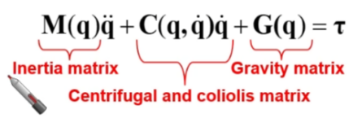

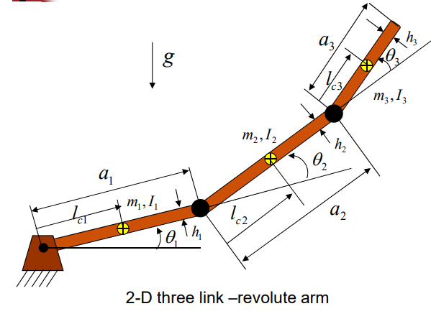
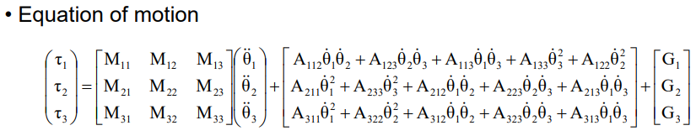

1강 로봇공학 개요
Dynamics:
Relationship between motion and forces
Rigid body dynamics
Inverse dynamics : Computes the required joint torques or forces that lead to the given robot motion
Forward dynamics : Computes robot motion from the joint torques or forces applied

Slide 8
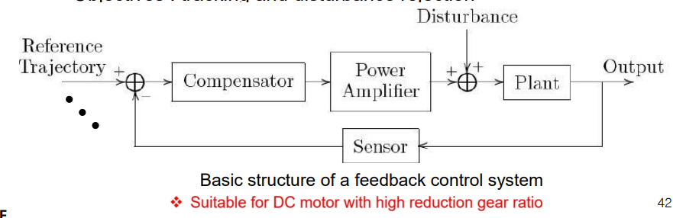
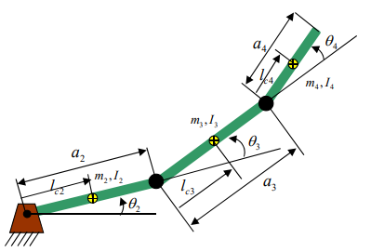
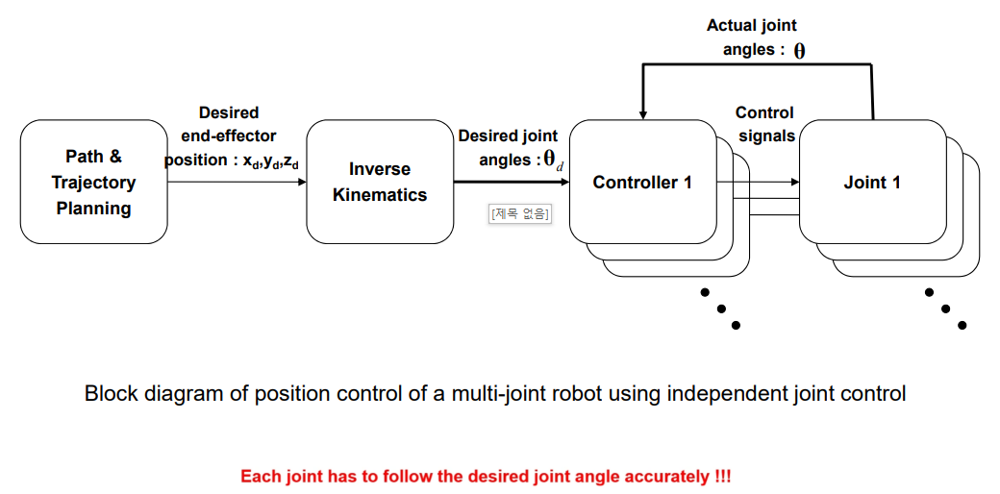
1강 로봇공학 개요
Independent Joint Position Control: any coupling effects due to the motion of the other links is ether ignored or treated as a disturbance.

Slide 9
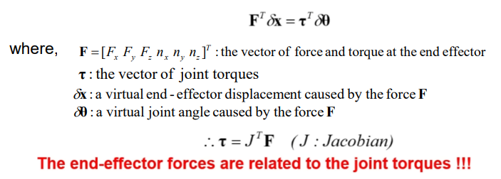
1강 로봇공학 개요
Force Control

Slide 10
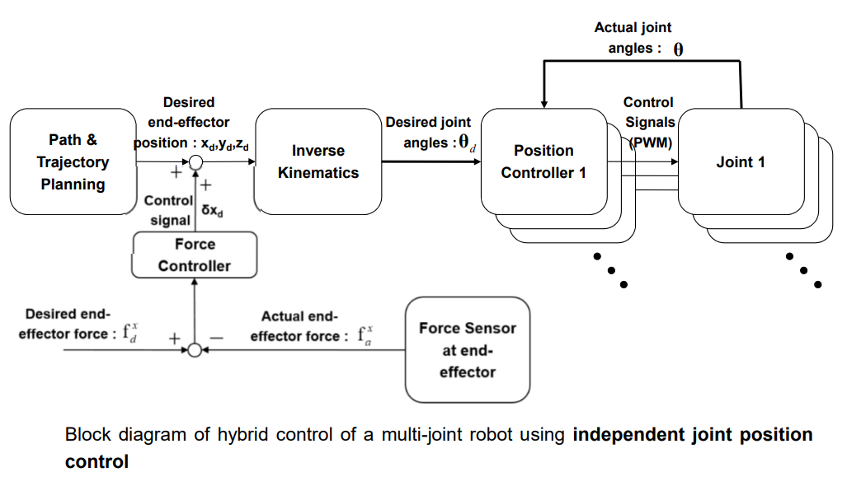
1강 로봇공학 개요
Hybrid Position/Force Control

Slide 11
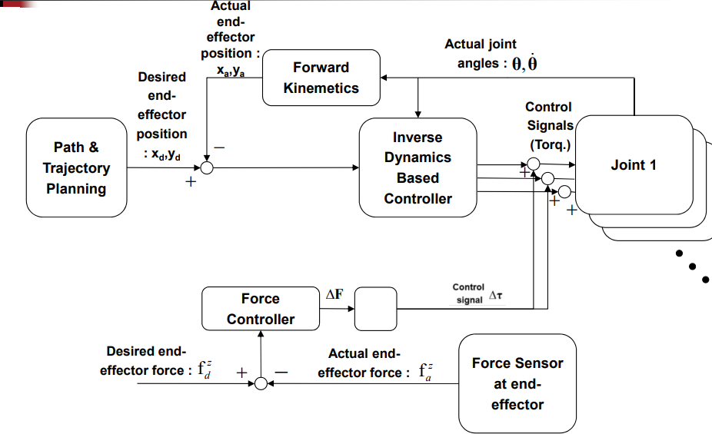
1강 로봇공학 개요
Hybrid Position/Force Control

Slide 12
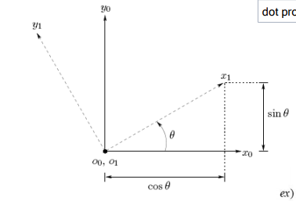
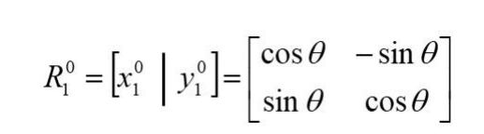

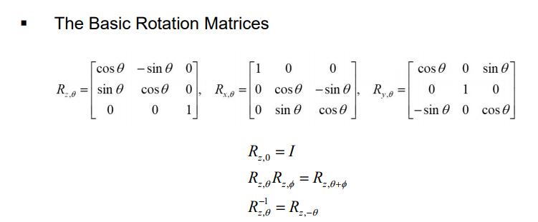
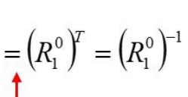
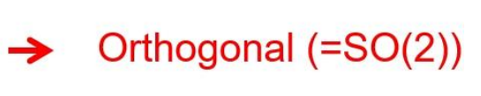
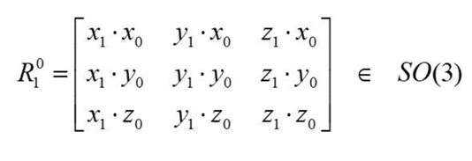




2강 로봇좌표 변환
Rotation in the plane
Rotation matrix:
Direction vector의 크기는 항상 1임
Dot product는 항상 0임

Slide 13
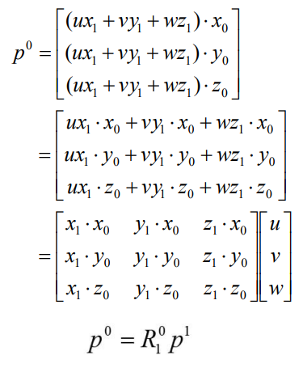

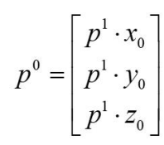
2강 로봇좌표 변환
Rotational Transformations

Slide 14


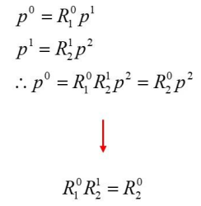
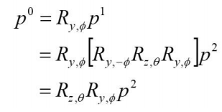
2강 로봇좌표 변환
Composition of rotations

Slide 15
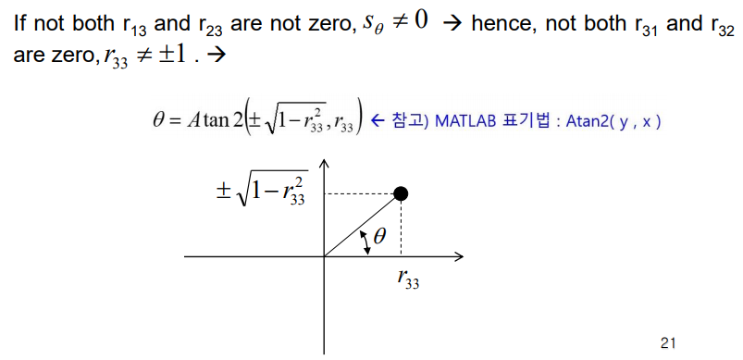
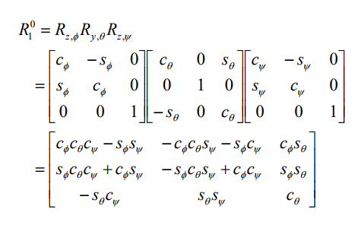
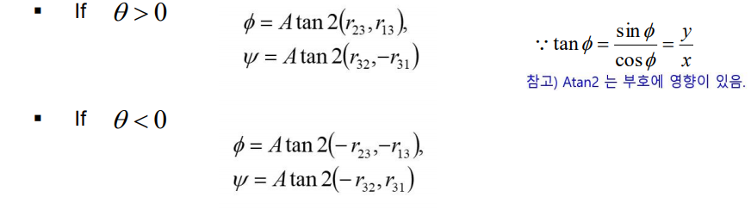
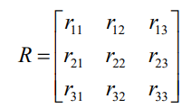
2강 로봇좌표 변환
Euler angles
Current coordinate frame
$∎$ If $r_{33}=±1$, there are infinitely many solution

Slide 16
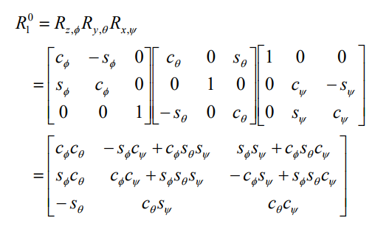
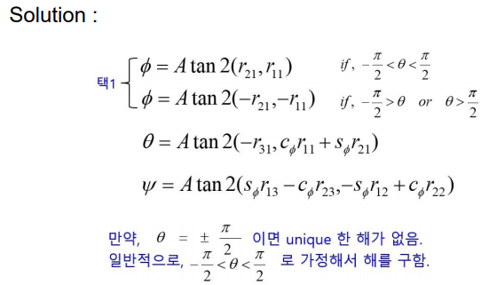
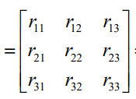
2강 로봇좌표 변환
Roll, Pitch, Yaw Angles
Fixed coordinate frame

Slide 17
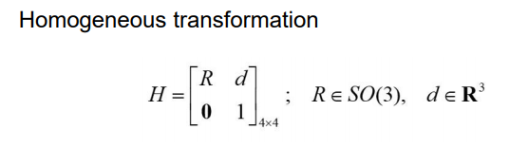
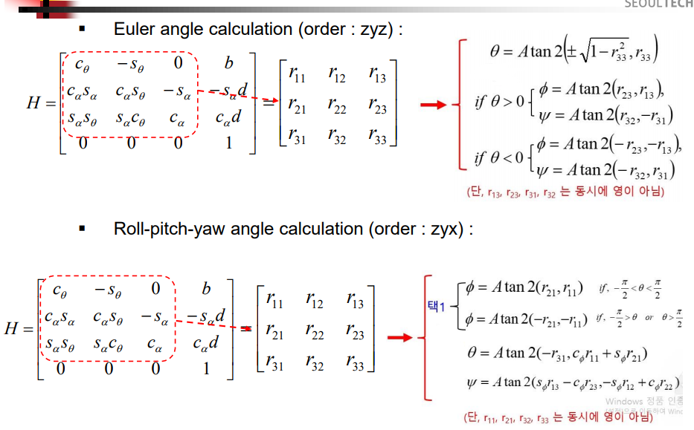
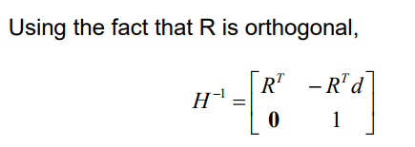

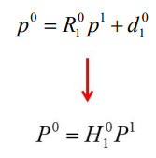
2강 로봇좌표 변환
Homogeneous Transformations

Slide 18
3강 로봇좌표 변환

